Slide 1
JAYPEE UNIVERSITY OF ENGINEERING
AND TECHNOLOGY
MINOR PROJECT-1
BATCH 2020-2024

Slide 2
Project Name: JUET Navigation App
Project Mentor
Dr. Amit Rathi
Project Members
Pratishtha Singh(201B194)
Prabal Sharma(201B180)

Slide 3
Need Of Navigation App
Problems in finding the right Classrooms, Lecture theater and Labs.
To help faculty members as well as students.

Slide 4


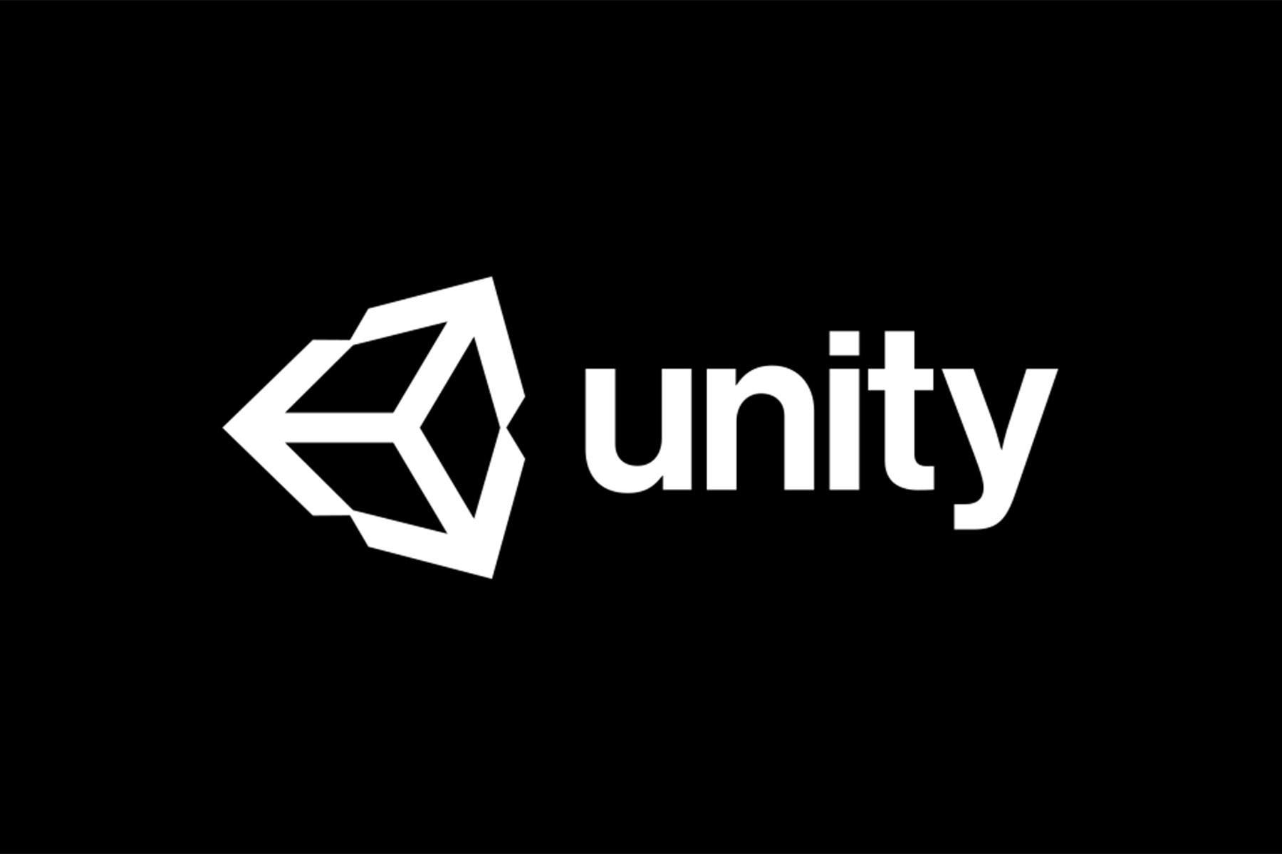
Tools and Software
Matterport
Vuforia Engine
Unity
3D camera
Vuforia Area Target Generator

Slide 5
Outline of Process
Mapping
Localization
Visualisation
Fig. 1

Slide 6
Flowchart
3D scan of area
Matterport camera
Expected Output
(Application)
3D scan of area
Area Target
Vuforia area target generator
Creating nodes/Points
Programming( C# or C++)
Unity engine
Fig. 2

Slide 7
Matterport
Matterport is a 3D modeling software.
Models can be kept private, shared publicly, or shared with a select group of collaborators.
It’s the quickest way to document a building or property.
Requirements
Scanning Environment
Creating point clouds
Creates Data model

Slide 8
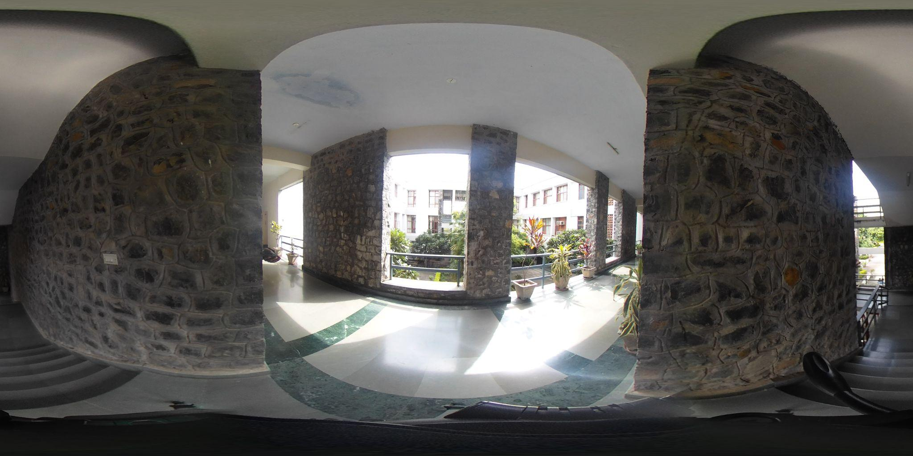
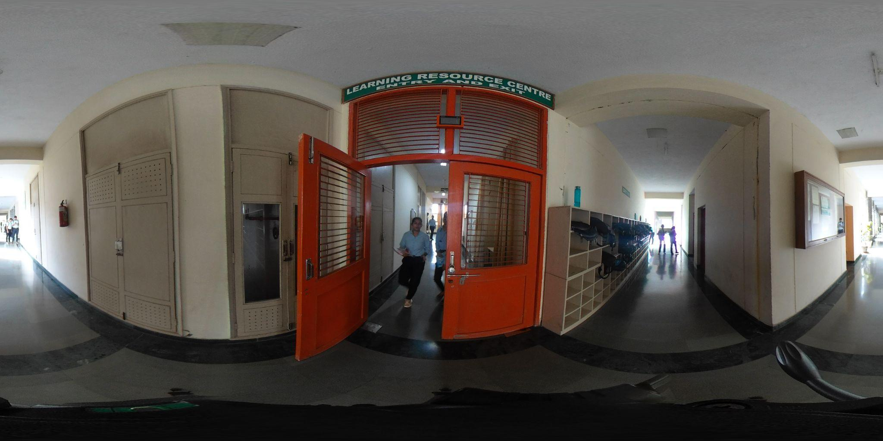
Scanned area by Matterport
360 Camera: Ricoh Theta SC2

Slide 9
Vuforia Area Target Generator
It’s a Vuforia engine tool that takes a 3d scanned model as input and generates an area target database.
We can review and edit the scan before generating an area target.

Slide 10
Vuforia Engine
Vuforia is an augmented reality software development kit (SDK) for mobile devices.
It enables the creation of augmented reality applications.
It uses computer vision technology to recognize and track 3D objects in real time.
Requirements
Optimized point cloud
Mesh for occlusion

Slide 11
Unity Engine
It’s cross-platform framework that allows you to write augmented reality experiences
In this Project we are using NavMesh components of unity engine.
With the help of NavMesh components
It indicate which surface is walkable and pathfinding can be done easily.
NavMesh agents tells about the user location.
Requirements
scanning of the data model with Unity Engine.
Generate walkable paths

Slide 12
Algorithms Applied
Dijkstra's Algorithm
It finds the shortest path between a given node and all other nodes.
Weights of the edges: In the Project we’ll be using distance in meters between the nodes.
A* Algorithm
It tries to look for a better path by using a heuristic function
It gives priority to nodes that are supposed to be better than others

Slide 13
Expected Input / Output
Input
Output
Destination point
Pathway to reach the destination by interacting the university’s model.
JUET Navigation App will ask from user to enter the destination point then application will show the path to reach the destination.

Slide 14
Problem Faced
To import the model from matterport to the unity Engine it’s demanding the paid version which is very costly.

Slide 15
Updates of Application
Virtual Tour
Description of the destination point

Slide 16
Thank You !

